Slide 1
Pointers and Arrays
Algorithm and programming
Shania Priccilia, S.Kom., M.Kom.

Slide 2
Learning Objectives
At the end of this session, student will be able to:
Explain the concept of array data and pointer (LO2 & LO3)

Slide 3
Subtopics
Pointer
Pointer to Pointer
Array
One Dimensional Array
Pointer Constant & Pointer Variable
Two Dimensional Array
Three Dimensional Array
Array of Pointer
Array of Character
String
String Manipulation
Exercise

Slide 4
Pointer
definition
Pointer is a variable that store the address of another variable
Syntax :
<type> *ptr_name;
Two operators mostly used in pointer : * (content of) and & (address of)
Example:
Initialize an integer pointer into a data variable:
  int i, *ptr;
  ptr = &i;
  To assign a new value to the variable pointed by the pointer:
  *ptr = 5; //means i = 5

Slide 5
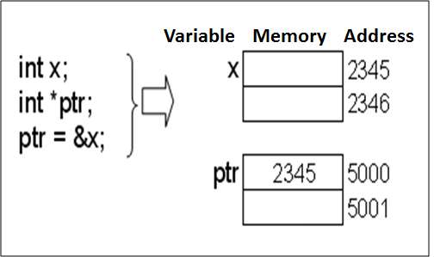
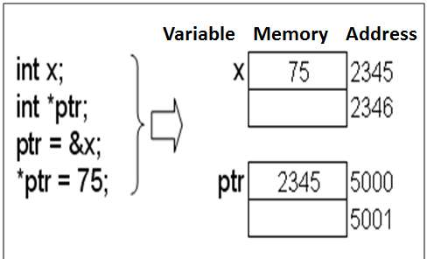
Pointer
concept

Slide 6
Pointer to Pointer
definition
Pointer to pointer is a variable that saves another address of a pointer
Syntax:
<type> **ptr_ptr;
Example:
  int i, *ptr, **ptr_ptr;
  ptr = &i;
  ptr_ptr = &ptr;
  To assign new value to i:
  *ptr = 5; // means i=5 ;
  **ptr_ptr = 9; // means i=9; or *ptr=9;

Slide 7
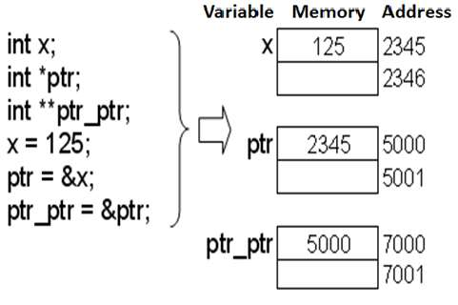
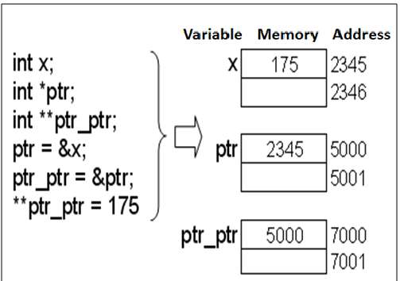
Pointer
concept

Slide 8
array
definition
An array is a data structure used to store multiple values of the same data type.
These values are stored in contiguous memory locations and can be accessed individually using an index.
All elements in an array share the same name, and the index (starting from 0) is used to distinguish between them.
Array characteristics:
  Homogenous → All elements have similar data type
  Random Access → Each element can be reached individually, does not have to be sequential

Slide 9
One dimensional array
definition
Syntax:
type array_value [value_dim];
Example :
int A[10];
The definition consists of 4 components:
  Type specified
  Identifier (name of the array)
  Operator index ([ ])
  Dimensional value inside operator [ ]

Slide 10
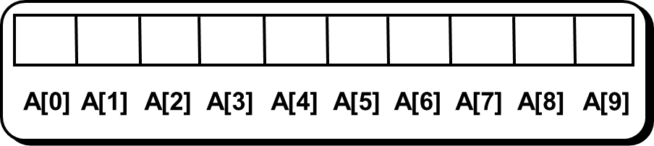
One dimensional array
concept
An illustration of array 1D
Elements of an array indexed starting from 0

Slide 11
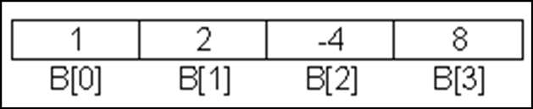
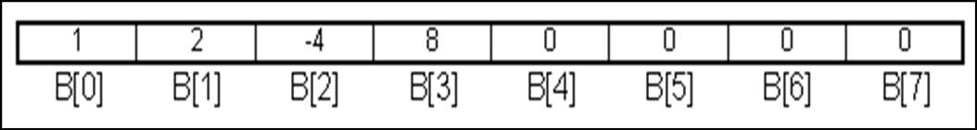
One dimensional array
initialization
Array can be initialized explicitly without dimensional value declaration
Example:
  int B[ ]={1, 2, -4, 8};
  int B[8]={1, 2, -4, 8};
Array B has 4 elements

Slide 12
One dimensional array
initialization
Example:
  int B[4] = { 1, 2, -4, 8, 9 }; //error
  *Error because array has fewer dimensions than expected.
  Array initialization after definition:
  int A[5];
  (for i=0; i<5; i++) A[i]=0;
  int B[5];
  B[5]={0,0,0,0,0};
√
Error, why ?

Slide 13
One dimensional array
Accessing array
Two analogous ways of accessing an element at index 2;
*(A+2)
or
A[2]
A is equivalent to &A[0]
It represents a constant pointer to the first element of the array.

Slide 14
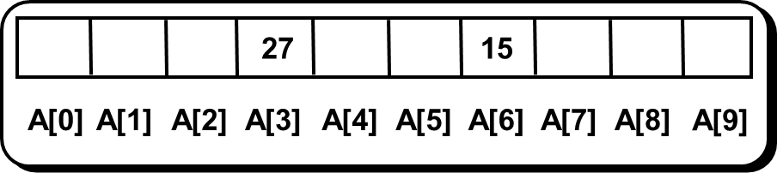
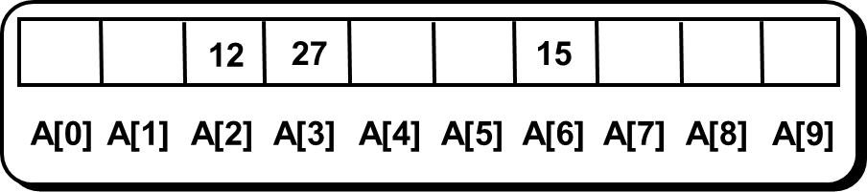
One dimensional array
Assigning Values
Assigning value to an element
Example :
  A[6] = 15; A[3] = 27;
  A[2] = A[3] - A[6]

Slide 15
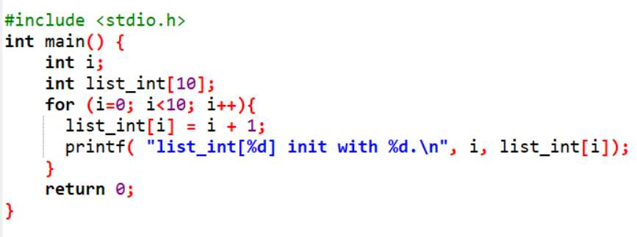
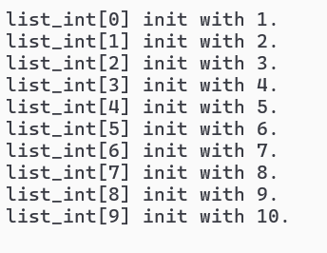
One dimensional array
examples
Output:

Slide 16
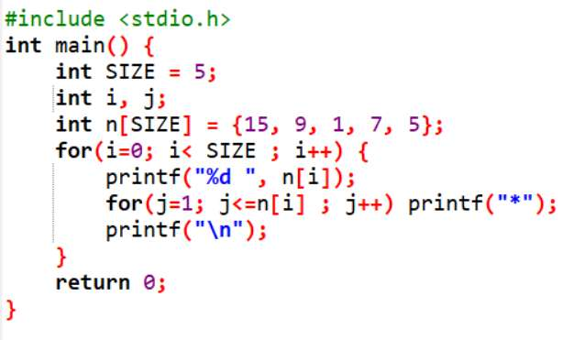
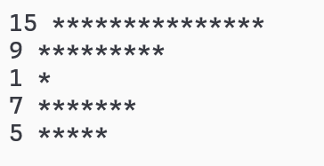
One dimensional array
examples
Output:

Slide 17
Pointer Constant & Pointer Variable
Definition & example
Pointer variable
  → Pointer that can be assigned with new value at run-time.
Pointer constant
  → Pointer that can not be assigned with new value at run-time
Array is Pointer Constant to its first element of the array. Array can be filled with pointer variable.
Example of pointer variable:
  int x=10, y=20;
  int *ptr; //ptr is pointer variable
  ptr = &x;
  ptr = &y;

Slide 18
Pointer Constant & Pointer Variable
Accessing Arrays
Example of pointer constant (array):
  int arr1[10];
  arr1[10] = {1, 2, 3, 4, 5}; // error
  Arr1 = {1, 2, 3, 4, 5}; // error
  arr1[10] = 12; // error max 9
  arr1[0] = 23; // ok
  int arr2[10] = {1, 2, 3, 4, 5}; //ok
*can only be initialized at definition time

Slide 19
Pointer Constant & Pointer Variable
Accessing Arrays
Accessing array using a pointer
  int arr[10];
  int *ptr_arr;
  ptr_arr = arr; //or ptr_arr = &arr[0];
To access certain element of array using pointer
  int arr[4] = {1,2,3,4}; // arr is an array (pointer constant)
  int *ptr = arr; // ptr is a pointer variable
  ptr = arr;
  printf("%d\n", *(ptr+1)); //output 2
  printf("%d\n", *(arr + 1)); //output 2
ptr is a pointer constant pointing to the first element of an array.
arr[1] analogous with *(arr+1)

Slide 20
TWO dimensional array
definition
C compiler does not limit number of dimensional which can be created. Our PC memory does.
Syntax:
type name_array[row][col];
Example :
int a[3][4];
Column 0
Column 1
Column 2
Column 3
Row 0
a[ 0 ][ 0 ]
a[ 0 ][ 1 ]
a[ 0 ][ 2 ]
a[ 0 ][ 3 ]
Row 1
a[ 1 ][ 0 ]
a[ 1 ][ 1 ]
a[ 1 ][ 2 ]
a[ 1 ][ 3 ]
Row 2
a[ 2 ][ 0 ]
a[ 2 ][ 1 ]
a[ 2 ][ 2 ]
a[ 2 ][ 3 ]
Column subscript
Array name
Row subscript

Slide 21
TWO dimensional array
initialization
Initialization: using row major order
Example :
int a[2][4] = {3,5,6,10,4,7,8,3};
int a[2][4] = {{3,5,6,10},{4,7,8,3}};
int b[2][4] = {{3},{4,7,8,3}};
int c[3][4] = {{3,5,6,10},
{4,7,8,3},
{1,2,3,4}};

Slide 22
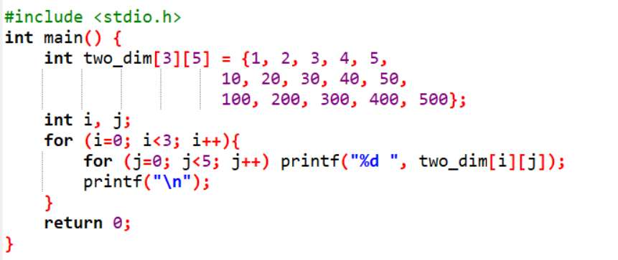

TWO dimensional array
examples
Output:

Slide 23
three dimensional array
definition
Syntax:
type name_array[row][col][depth];
Example :
int x[3][2][4] = {{{1,2,3,4}, {5,6,7,8}},
{{11,12,13,14}, {15,16,17,18}},
{{21,22,23,24}, {25,26,27,28}}};
int x[4][3][5] = {{{1, 2, 3}, {0, 4, 3, 4}, {1, 2}},
{{9, 7, 5}, {5, 7, 2}, {9}},
{{3, 3, 5}, {2, 8, 9, 9}, {1, 2, 1}},
{{0}, {1}, {0, 1, 9}}};
printf(“%d”, x[2][1][3]);

Slide 24

Array of Pointer
definition
Array filled with pointers
Syntax:
type *array_name [value_dim];
Example :
int i;
int *ptr[4];
int x=1, y=2, z=3, w=5;
ptr[0]=&x;
ptr[1]=&y;
ptr[2]=&z;
ptr[3]=&w;
for(i=0;i<4;i++) printf("%d ",*ptr[i]);
Output:

Slide 25
Array of character
definition
Array filled with characters
Syntax:
char array_name[value_dim];
Example :
char name[40];
char ss[20]={'B','I','N','U','S'}; //20 elements
char ss[ ]= {'B','I','N','U','S'}; // 5 elements

Slide 26
String
definition
Characters are the fundamental building blocks of source programs.
We have learned about character previously
A string is a series of characters treated as a single unit.
String may include letters, digits and various special characters such as +, -, *, / and $
String is an array of character that ended with null character ( ‘\0’ or in ASCII = 0).

Slide 27
String
definition
String constant or string literal is some characters written between double quote
Example: "Welcome"
  Above string will have character of 'W','e','l','c','o','m','e', and '\0'.
String constant type is pointer constant, thus can be assigned to an array of character.
Example :
  char name[40] = "Amir"; //ok
  name = "Amir"; // error name is a constant pointer
  Name[40]= "Amir"; //error

Slide 28
String
definition
A Constant String can be linked at compile-time:
Example:
  "Hello, world"
Example string initialization:
  char s[ ] = "BiNus";
Similar to :
  char s[ ] = {'B','i','N','u','s','\0'};
String as a data type does not known in C

Slide 29
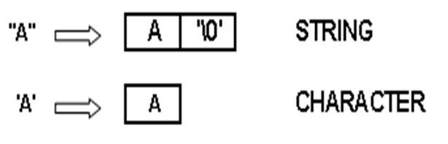
Char vs string
definition
Character in c written between single quote. Each uses one byte of computer memory.
Example of Character:
  char ch='A';
  char ch=65; //Ascii
  char ch=0x41; //Ascii
String written in between double quote.
Example of String:
  char ch[]="A";
Similar

Slide 30
character MANIPULATION
The character-handling library (<ctype.h>) includes several functions that perform useful tests and manipulations of character data.
Each function receives an unsigned char (represented as an int) or EOF as an argument.
Function | Description
int isblank(int c); | Returns a true value if c is a blank character that separates words in a line of text and 0 (false) otherwise.
int isdigit(int c); | Returns a true value if c is a digit and 0 (false) otherwise
int isalpha(int c); | Returns a true value if c is a letter and 0 (false) otherwise.
int isalnum(int c); | Returns a true value if c is a digit or a letter and 0 (false) otherwise.
int islower(int c); | Returns a true value if c is a lowercase letter and 0 (false) otherwise.

Slide 31
character MANIPULATION
Function | Description
int isupper(int c); | Returns a true value if c is an uppercase letter and 0 (false) otherwise.
int tolower(int c); | If c is an uppercase letter, tolowerreturns c as a lowercase letter. Otherwise, tolowerreturns the argument unchanged.
int toupper(int c); | If c is a lowercase letter, toupperreturns c as an uppercase letter. Otherwise, toupperreturns the argument unchanged.

Slide 32
character MANIPULATION
Function | Description
int isspace(int c); | Returns a true value if c is a whitespace character—newline ('\n'), space (' '), form feed ('\f'), carriage return ('\r'), horizontal tab ('\t') or vertical tab ('\v')—and 0 (false) otherwise.
int iscntrl(int c); | Returns a true value if c is a control character— horizontal tab ('\t'), vertical tab ('\v'), form feed ('\f'), alert ('\a'), backspace ('\b'), carriage return ('\r'), newline ('\n') and others— and 0 (false) otherwise.

Slide 33
STRING MANIPULATION
definition
In Standard Library Function (header file string.h) provides functions to manipulate string:
strlen() → Return a value of string length; excluded null char
strcpy(s1,s2) → Copy s2 to s1
strncpy(s1,s2,n) → Copy first n characters of s2 to s1
strcat(s1,s2) → Adding string s2 to the end of string s1
strncat(s1,s2,n) → Adding n characters of string s2 to the end of string s1
strcmp(s1,s2) → Comparing the value of string s1 and s2, if similar returning 0
etc.

Slide 34
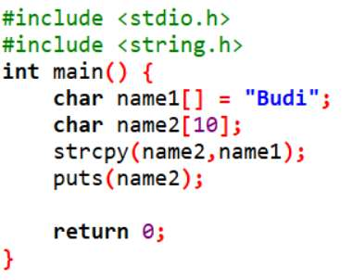
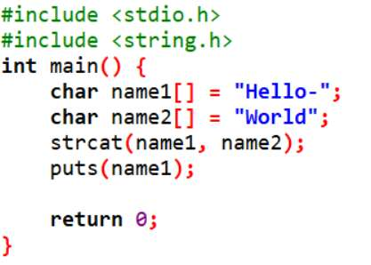
STRING MANIPULATION
examples
Output:
Budi
Output:
Hello-World

Slide 35
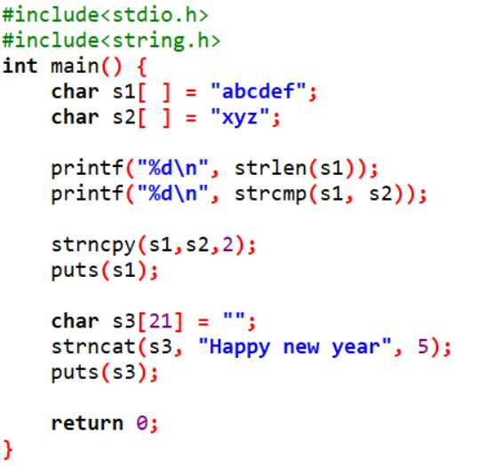
STRING MANIPULATION
examples
Output:
6
-1
xycdef
Happy

Slide 36
String conversion
string-conversion functions are function included in the general utilities library (<stdlib.h>).
These functions convert strings of digits to integer and floating-point values.
Functions included are strtod, strtol, strtoul.
Function | Description
double strtod(const char *nPtr, char **endPtr); | Converts the string nPtr to double.
long strtol(const char *nPtr, char **endPtr, int base); | Converts the string nPtr to long.
unsigned long strtoul(const char *nPtr, char **endPtr, int base); | Converts the string nPtr to unsigned long.

Slide 37

STRING conversion
examples
#include <stdio.h>
#include <stdlib.h>
int main(void)
{
char *stringPtr; // create char pointer
const char *string = "51.2% are admitted"; // initialize string
double d = strtod(string, &stringPtr);
printf("The string \"%s\" is converted to the\n", string);
printf("double value %.2f and the string \"%s\"\n", d, stringPtr);
}

Slide 38

STRING MANIPULATION
examples
#include <stdio.h>
#include <stdlib.h>
int main(void){
  const char *string = "-1234567abc";
  char *remainderPtr;
  long x = strtol(string, &remainderPtr, 0);
  printf("%s\"%s\"\n%s%ld\n%s\"%s\"\n%s%ld\n",
  "The original string is ", string,
  "The converted value is ", x,
  "The remainder of the original string is ",
  remainderPtr,
  "The converted value plus 567 is ", x + 567);
}

Slide 39
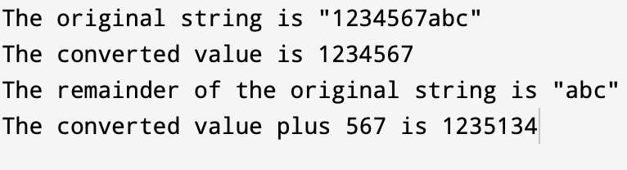
STRING conversion
examples
#include <stdio.h>
#include <stdlib.h>
int main(void){
  const char *string = "1234567abc"; // initialize string pointer
  char *remainderPtr; // create char pointer
  unsigned long int x = strtoul(string, &remainderPtr, 0);
  printf("%s\"%s\"\n%s%ld\n%s\"%s\"\n%s%ld\n",
  "The original string is ", string,
  "The converted value is ", x,
  "The remainder of the original string is ",
  remainderPtr,
  "The converted value plus 567 is ", x + 567);
}

Slide 40
exercise
Question 1
Create a program to get 10 integer values from keyboard and store in an array. Find out:
Max value inside the array
Min value inside the array
Calculate average value of the array
Show the result to the monitor

Slide 41
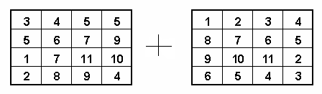
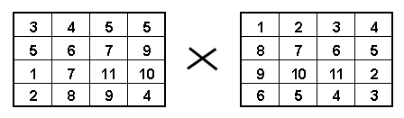
exercise
Question 2
Create a program of matrix addition. Use 2D array!
Question 3
Create a program of matrix multiplication. Use 2D array!

Slide 42
exercise
Question 4
Given the following Arrays:
int A[3][4]={1, 3, 2, 4, 5, 7, 6, 8, 9,11, 12 };
int B[3][3]={{1, 2}, {3, 4, 5} ,{ 7 }};
What are the values of:
A[1][1] = ?
B[2][2] = ?
A[2][3] = ?
B[0][1] = ?
A[0][2] = ?

Slide 43
exercise
Question 5
Create a program that display user input, with no extra space (single whitespace followed by multiple whitespace(s)).
Question 6
Create a program that validate a user input for password. String must contain: Upper case, lower case, special character (_/@-!?*#) , number, no whitespace, and maximum length is 12.
Question 7
Create a program in C to rotate a string. Example:
Sample Input | Sample Output
KASUR | RUSAK

Slide 44
SUMMARY
Pointer is a variable that store the address of another variable
Pointer to pointer is a variable that saves another address of a pointer
Data saved in a certain structure to be accessed as a group or individually. Some variables saved using the same name distinguish by their index which called as an array
Character is a variable that represented by int in ASCII table. ​
String is an array of character that ended with null character. ​
There are multiple function in handling character​
Same as character, there are multiple function in handling string.

Slide 45
REFRENCES
Paul Deitel & Harvey Deitel. (2021). C how to program. 09. Pearson Education. New York. ISBN: 9780137398393.
C Programming – Pointers: http://www.exforsys.com/tutorials/c-language/c-pointers.html
Storing Similar Data Items: http://aelinik.free.fr/c/ch12.htm
String manipulation: https://www.geeksforgeeks.org/string-functions-in-c/

